Slide 1

JavaScript Fundamentals
Course Introduction
SoftUni Team
Technical Trainers
Software University
https://softuni.bg/

Slide 2
Table of Contents
Introduction
Course Objectives
Trainers and Team
Course Details

Slide 3
Have a Question?
sli.do
#fund-js

Slide 4











SoftUni Diamond Partners

Slide 5



Educational Partners

Slide 6

JS Fundamentals
Course Objectives

Slide 7
Course Objectives
Working with linear data structures
Arrays
Defining functions and simple classes
Working with objects
Processing and manipulating strings
Regular expressions

Slide 8
JS Fundamentals – Course Topics
Basic Syntax, Conditional Statements And Loops
Data Types and Variables
Arrays
Functions
Arrays Advanced
Objects and Classes
Associative Arrays
Text Processing
Regular Expressions

Slide 9

Trainers and Team

Slide 10
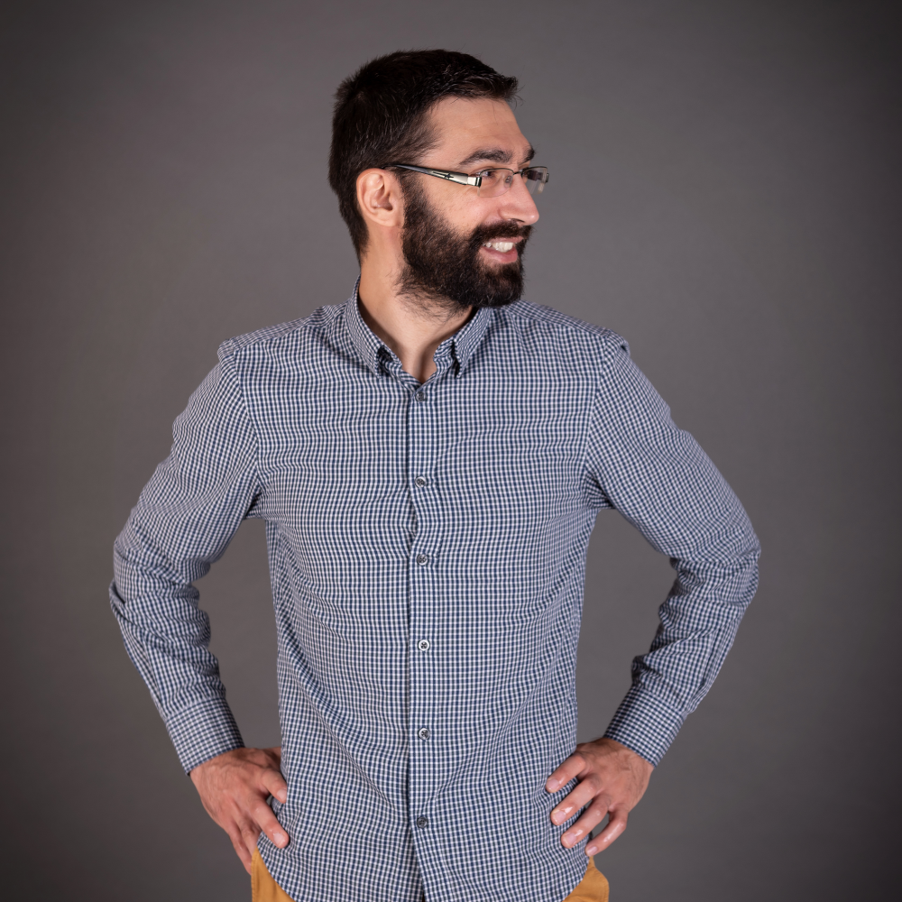
Viktor Kostadinov
Senior technical trainer with 5 years experience in the IT field
Head of the R&D Unit at Software University
Former Director of the Education Department
JavaScript enthusiast

Slide 11
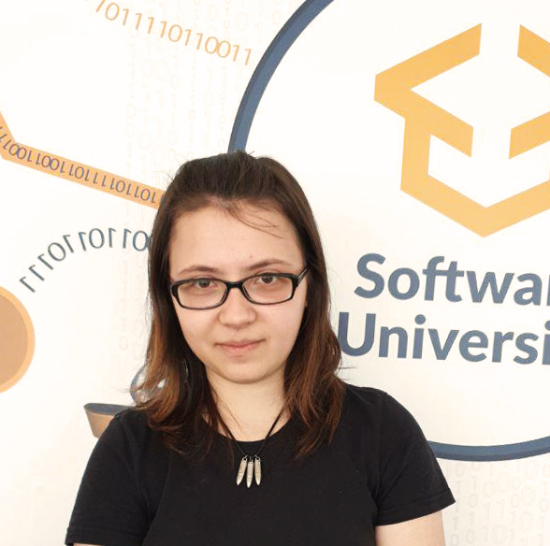
Tanya Staneva
Currently working as Software Developer (React, Node, Express, Mongo)
Technical Trainer and Former Team Lead at SoftUni
Graduated SoftUni student (JavaScript Developer)
Interested in Machine Learning and AI

Slide 12

Course Details
Schedule

Slide 13

Practical Programming Exam
Mid Exam
3 practical problems for 4 hours
Conditional Statements and Loops
Linear Data Structures – Arrays
Final Exam
3 practical problems for 4 hours
Associative Arrays
Strings and Text Processing
Regular Expressions
Link to Exams

Slide 14
Theoretical Exam
20 questions for 30 minutes
Multiple choice
English
Automated quiz system
Available online – open when the practical exam starts and active 30 minutes after it's end
You can submit your answers just one time

Slide 15
JS Fundamentals Module Timeline
JS Fundamentals
12 weeks
3 times per week
12 credits
Start: 17. May 2021
Mid-Exam: 10. Jul 2021 Final-Exam: 14. Aug 2021
Exam Retakes
Mid-Exam: 17. Aug 2021 Final-Exam: 20. Aug 2021
17.
10.
14.
May
June
July
August

Slide 16
Course Scoring
Practice grade:
Theory grade:
SoftUni Certificate: 5.00 from Practice
CPE Certificate: 3.00 average from Practice + Theory
Practical Mid Exam
Practical Final Exam
Homework
40 %
60 %
+5 %
Theoretical Exam
100 %
16

Slide 17

Homework Assignments & Exercises
Your homework is mainly work in class
Lesson days → slides + live demos + exercises
Exercise days → only exercises
How to submit your homework?
Submitted in the judge system
Do your homework when it's due
Assignments pile up quickly

Slide 18




Course Web Site, Forum
Official web site:
Official discussion forum:
Official JavaScript Facebook group:
Official SoftUni JavaScript Community:
https://softuni.bg/js-fundamentals-may-2021
https://softuni.bg/forum/programming-fundamentals
https://www.facebook.com/groups/JSFundamentalsMay2021
https://facebook.com/groups/SoftUniJavaScriptCommunity

Slide 19
Questions?
Notes:
19

Slide 20
Trainings @ Software University (SoftUni)
Software University – High-Quality Education, Profession and Job for Software Developers
softuni.bg
Software University Foundation
softuni.foundation
Software University @ Facebook
facebook.com/SoftwareUniversity
Software University Forums
forum.softuni.bg
Notes:
20

Slide 21

License
This course (slides, examples, demos, exercises, homework, documents, videos and other assets) is copyrighted content
Unauthorized copy, reproduction or use is illegal
© SoftUni – https://softuni.org
© Software University – https://softuni.bg
Notes:
21

